Slide 1
The Use of AI & Machine Learning with Classifying & Predicting Types of Social Media Posts
Ciaran O’Dwyer - S15111608
CMP7161 Advanced Data Science A S2 2018/9

Slide 2
Abstract
For this project, machine learning techniques were used in order to predict types of social media posts on Facebook by using their interaction data as features. Two machine learning algorithms were used, these being decision trees and support machine vectors.While both produced high levels of accuracy, the poor weighting of the data produced lower levels of accuracy than desired.

Slide 3
Dataset
The dataset used for this project was the Facebook Comment Volume Dataset, provided by the UCI Machine Learning Repository.
The Dataset contains various data from a popular Facebook group.
Data measured includes post interactions, media format and the main measures of post popularity. These are “likes”, “comments” and “shares”.

Slide 4
Data Pre-Processing and Feature Selection
To prepare the data for processing, the dataset was edited so that various data entries that were missing were removed.
The dataset was also converted into a “.csv” format so it could be processed.
Dataset consisted of 500 entries.
For the project, the features to analyse were the “likes”, “comments” and “shares”.
The Target was the type of post, which ranged from “Photo = 1”, “Link = 2”,
“Text = 3” and “Video = 4”.
Notes:
AFTER THIS SLIDE, DO A SLIDE ON VISUALISATION WHERE I PLOT THE NUMBER OF INSTANCES OF EACH TIME. BASICALLY SAY HOW MUCH OF EACH TYPE OF POST YOU GOT

Slide 5
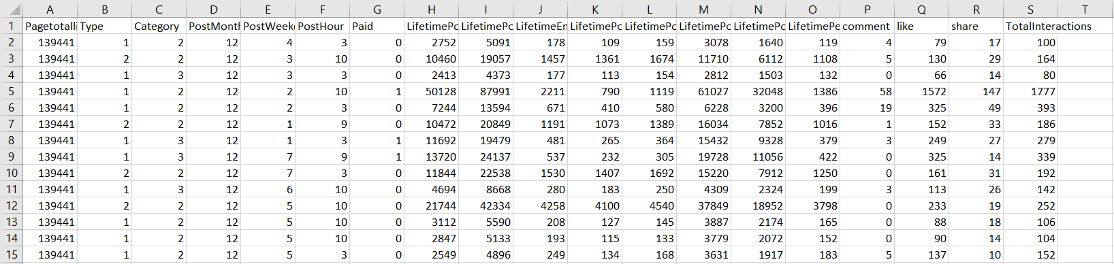
Dataset Visualisation and Overview
Dataset initially contained 501 data entries, however 1 was removed due to missing entries leaving the dataset with 500 entries.
This dataset contained 7 videos, 22 links, 48 statuses and 424 photos.
Data set is fairly imbalanced, so it may impact the data.

Slide 6
Decision Trees
Non-Supervised method of learning, used for classification and regression.
Model functions by predicting target variable via decision rules from features data.

Slide 7
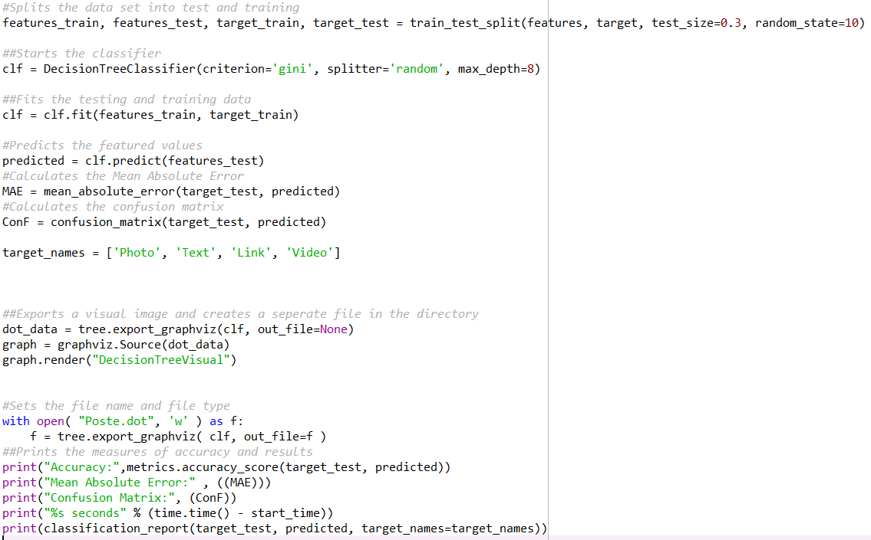
Decision Tree - Code

Slide 8
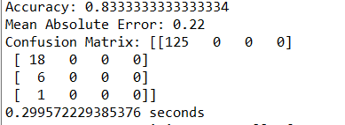
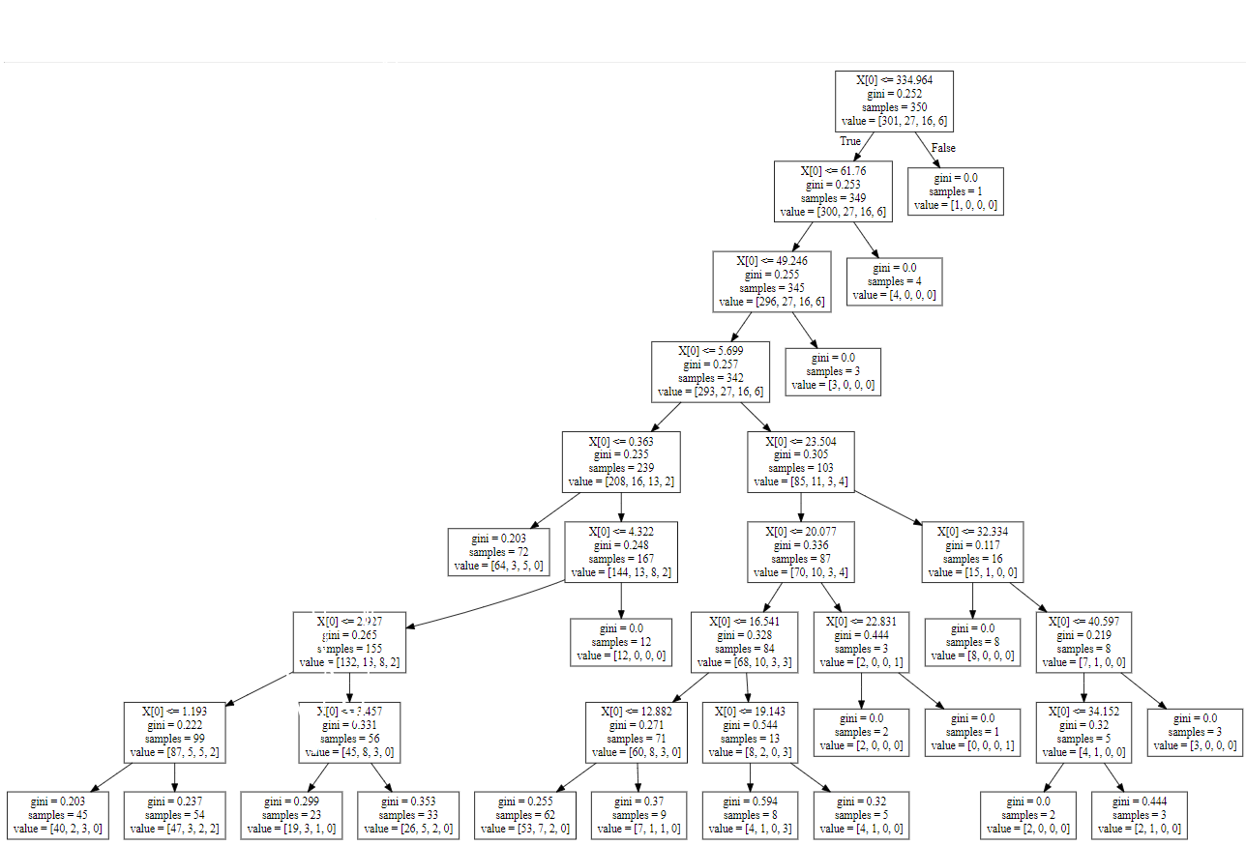
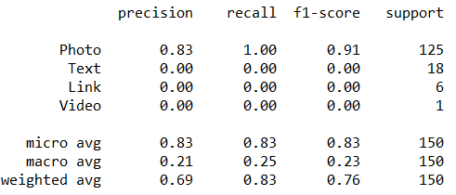
Decision Tree - Results
Notes:
Confusion matrix shows large total of photos being correctly predicted, but massive data inbalance provides poor data for the rest
Classification report shows massive imbalance as well
Decision tree also has poor balance of depth, caused by sheer abundance of photo data

Slide 9
Support Machine Vector
Supervised Method of Learning, used for classification and regression.
Memory efficient, using support vectors as a subset of training points.

Slide 10
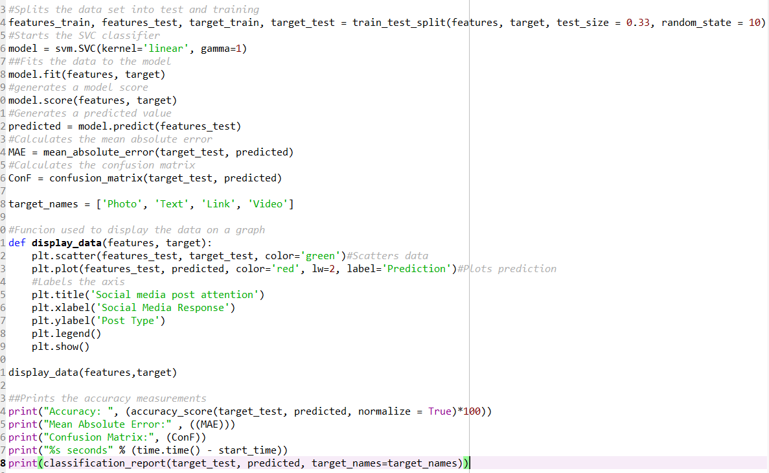
Support Vector Machine - Code

Slide 11
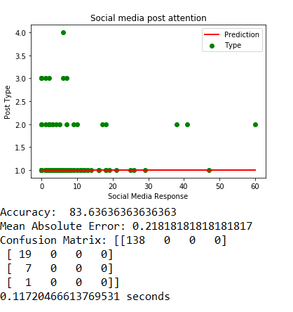
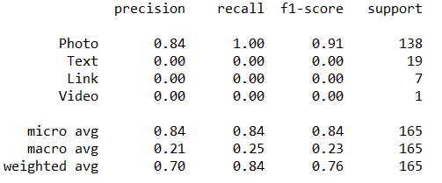
Support Vector Machine - Results
Notes:
Same deal as the decision tree but way more accurate

Slide 12
Model Comparison
 | Decision Tree | Support Vector Machine
Accuracy | 83.4% | 83.63%
Mean Absolute Error | 0.22 | 0.21...
Overall, Support Vector Machine provided more accurate predictions and classification, however the dataset was imbalanced towards photos meaning all measures greatly favoured photos as the prediction criteria.

Slide 13
Results Summary
From the results, it was found that there is some potential in using social media attention to predict the type of post.
From the machine learning predictions, photos were shown the gain the most attention and videos the least, allowing for predictions to be made.
However, data set imbalance has impacted the reliability of this dataset, with 424 out of the 500 data entries being photos.

Slide 14
Conclusion and Recommendations
In conclusion, while the classification and prediction of facebook post type is possible, lots more research would have to be conducted to make it viable.
It would be recommend to create or balance a new dataset to gain more data on the popularity of the social media post types. EG. Using Smote Imlearn to auto balance data.
Using more methods of supervised learning may also help with understanding of data.
Notes:
SMOTE imlearn

Slide 15
References
https://scikit-learn.org/stable/modules/model_evaluation.html#confusion-matrix
https://scikit-learn.org/stable/modules/svm.html#svm
https://scikit-learn.org/stable/modules/tree.html
http://archive.ics.uci.edu/ml/datasets/Facebook+Comment+Volume+Dataset
https://imbalanced-learn.readthedocs.io/en/stable/generated/imblearn.over_sampling.SMOTE.html

